Slide 1
T863203 3CR
LOCATION TECHNOLOGIES
BASIC PRINCIPLES AND THEORIES
Senior Lecturer Riitta Rontu, M.Sc (Eng.)
Oulu University of Applied Sciences

Slide 2
Basic Measurements: videos
JPR
Learning task 2 includes also some videos, made by author of the course book, Alan Bensky.
In the videos he explains mostly the same things that are presented in the book
Use the videos as a support if You like. The other possibility is to only read the book. I found the videos very good, the author is explaining everything very calmly.
The video links are given in learning task file

Slide 3
Basic Measurements
JPR
There are three basic properties that enable distance measurement and location from analysis of specific physical charasteristics of radio signals:
    Received signal strength (RSS)
    Time of flight (TOF)
    Angle of arrival (AOA) or direction of arrival (DOA)
All methods of distance measurement and location are derived from the measurements above, alone or in combinations. There are two variants of these methods that differ enough from the normal cases:
    Proximity
    Fingerprinting

Slide 4
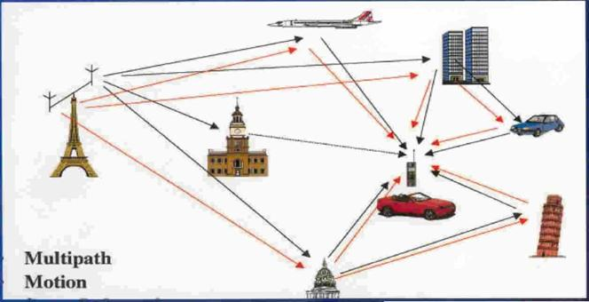
Basic Measurements (cont.)
JPR
Received signal strength (RSS)
  Signal level is used to estimate the distance
  Signal level depends on the distance between the modules
    The power density of an electromagnetic wave is propotional to transmitted power and inversely propotional to the square of the distance to the source
  Accuracy vary according to different environments. Many aspects affect the signal: multipath fading, buildings, weather …
  The attenuation that is caused by other means than increasing the distance is calculated and tried to be separated with mathematical models

Slide 5
Basic Measurements (cont.)
JPR
Time of flight (TOF)
  The distance between a transmitter and receiver equals the time of flight (propagation time) of the transmitted signal times the speed of propagation
  The distance can be determined from measurement of time of arrival (TOA) of a signal at the receiver when transmission time is known or from differences of reception time at different locations (time difference of arrival, TDOA)
  Another expression of TOF is the phase of the received signal, which may be referred to as phase of arrival (POA), since phase may be related to time and distance through the signal wavelength and speed of light

Slide 6
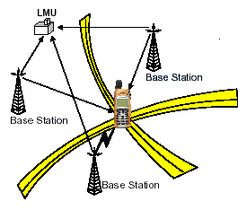
Basic Measurements (cont.)
JPR
Time of arrival (TOA)
  Time of arrival data from two base stations will narrow a position to two circles and data from a third base station is required to resolve the precise position with the third circle when matching in a single point. There are many ToA-based localization systems, including GPS.
  The drawback of TOA is that it requires an expensive monitoring equipment (LMU) to maintain accurate synchronized clocks in all stations participating in the measurements.

Slide 7
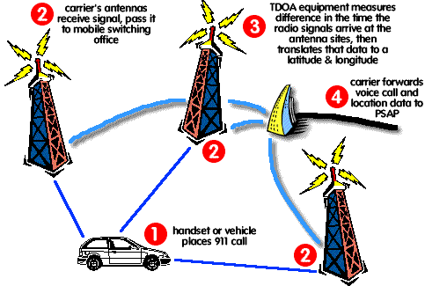
Basic Measurements (cont.)
JPR
Time difference of arrival (TDOA)
  The process of locating an object by accurately computing the time difference of arrival (TDOA) of a signal emitted from the object to three or more receivers.
  In unsyncronised networks the measurement has to be done from time differences
  Need for transmission that has a recognizable unambiguous starting point

Slide 8
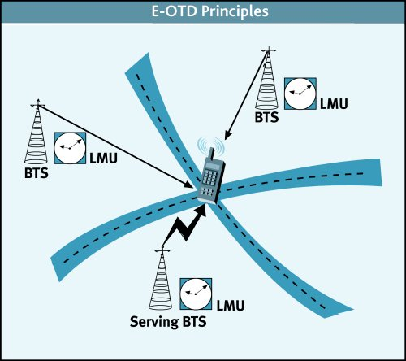
Basic Measurements (cont.)
JPR
Enhanced observed time difference (E-OTD)
  The mobile measures the observed time differences of received signals from pairs of base stations in known locations. The method is the same as in TDOA but the measurement is done by the mobile.
  The terminal must be capable of contacting many base stations and calculating the location from time differences in signals or sending the information to server in the network
  At least three base stations are measured to obtain the exact position

Slide 9
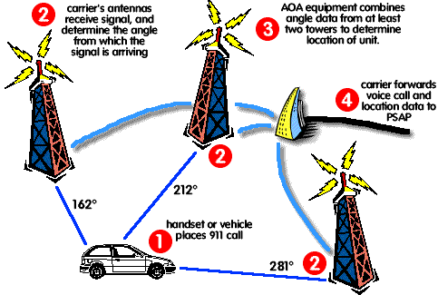
Basic Measurements (cont.)
JPR
Angle of arrival (AOA) or direction of arrival (DOA)
  Directional antennas are used to estimate the angle from which the signal arrives.
  The angle of arrival may be determined to be the point in the pattern rotation where the signal strength is maximum (knowledge of transmitted power is not needed).
  At least two estimates are needed.

Slide 10
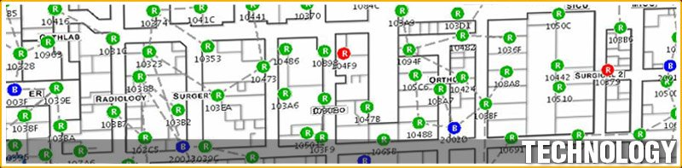
Basic Measurements (cont.)
JPR
Proximity
    Refers to detection of a mobile terminal as being within radio range of a fixed location so that the mobile is known to be within an area around that location

Slide 11
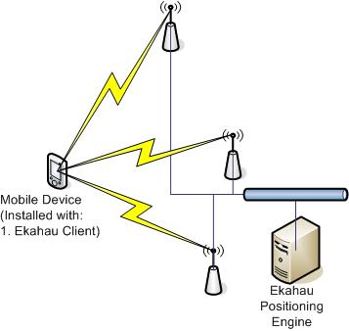
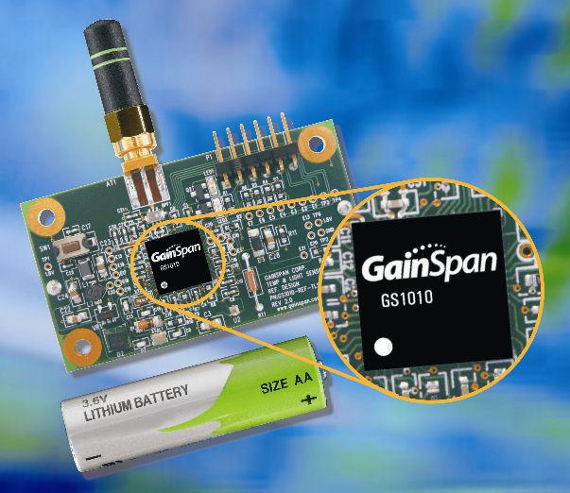
Basic Measurements (cont.)
JPR
Fingerprinting
    Locates terminal by comparing various characteristics of a signal or signals received at or from that terminal with a database of the same type of characteristics that has been compiled in advance over a given area or volume

